Slide 1
Rich Bradley
Data Analyst: Flight Delays Project
Advanced Analytics & Dashboard Design
https://www.linkedin.com/in/rich-bradley-mba/

Slide 2


Table of Contents
Project Introduction
Limitations and Ethical Considerations
Correlation Matrix
Normalization and Scatterplots
Flight Delays by Airport
Choropleth Map of US and Airport Names
Airlines Affected by Delays
Recommendations
Sources
Links
Concluding Slide

Slide 3
Introduction: Flight Delay Project
I chose this data set for my project, seeing that people are traveling again, and air travel is up since Covid-19. With an increase demand for air travel and hearing about delays on the news, I wanted to research what are the causes of air travel delays.
This information could be a benefit for future travel and travelers to better understand the causes of delays in the air travel industry and provide insight for airlines to improve their customer travel experience.
The Objective
Determine the flight delays greater than 15 minutes
Which airlines are impacted the most

Slide 4
Limitations and Ethical Considerations
The data set is limited to two years of information, 2019 and 2020. Hopefully, the author will continue to update and collect additional information to identify trends of air travel delays.
The source of the data is from the United States Department of Transportation. Since this is from a government source this data can be trusted.
Although there is no personal information within the data set, airlines and airports are named, which is good information for air travelers. However, may have a financial impact, negative or positive for the named airlines and airports.

Slide 5
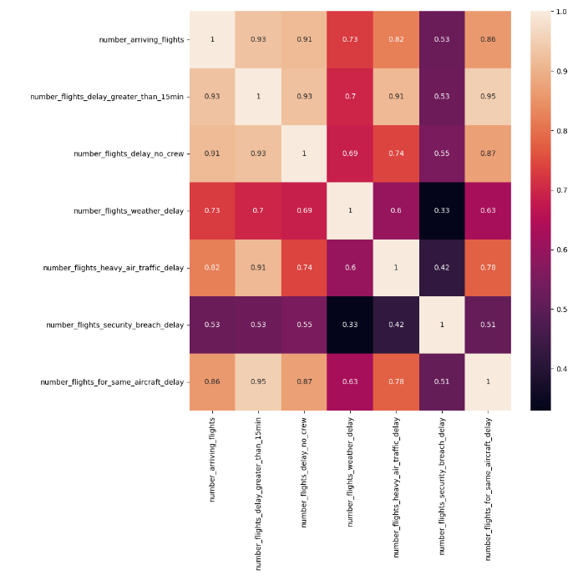
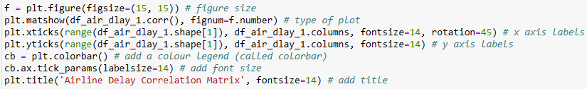

Correlation Matrix
This heatmap shows the correlation of the different delay categories and how strong or weak the correlations are in relationship to each delay.
The coefficient range between .3 - .5, the darker purple colors show a weak relationship.
The coefficient range between .5 – .7 the purple to red colors shows a moderate relationship.
The coefficient range between .7 – 1.0, the darker beige to light beige colors shows a strong relationship between the variables.

Slide 6
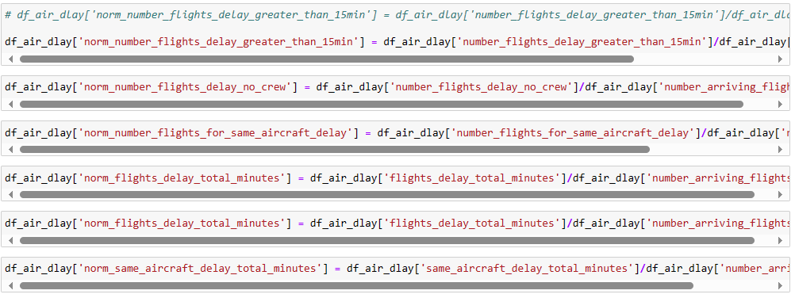
Normalization and Scatterplots
Since there are different numbers of arriving flight for the variety of airlines, normalizing the data was important to create ‘fairness’ between the airlines and the different delays.

Slide 7
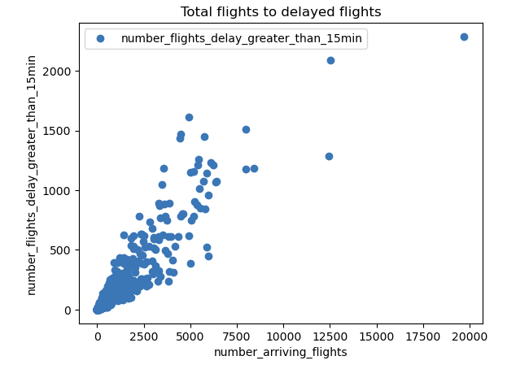
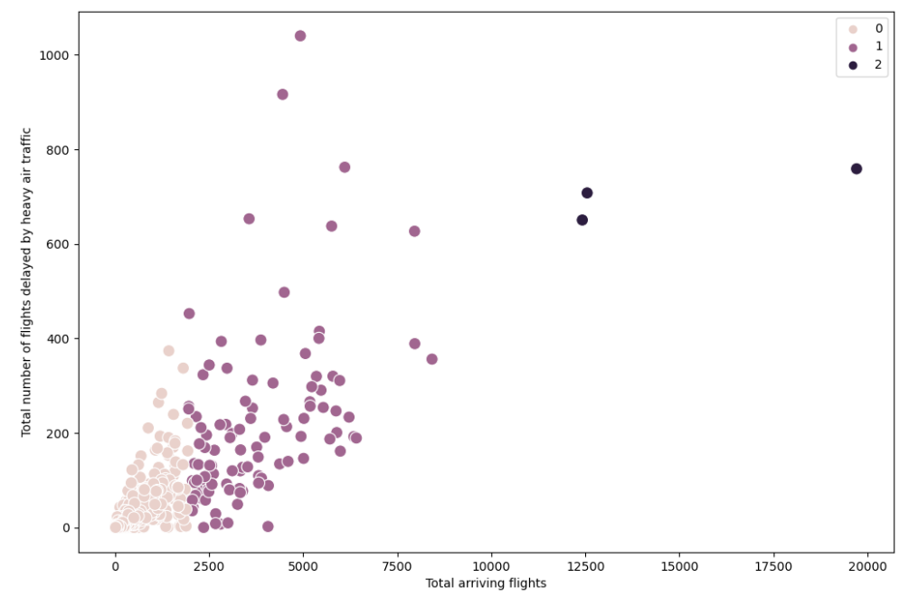
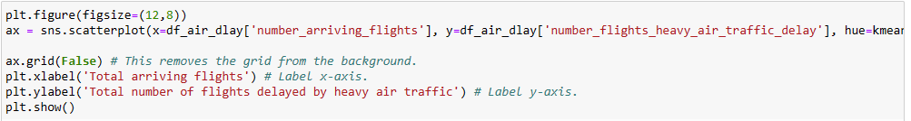
Normalization and Scatterplots

Slide 8
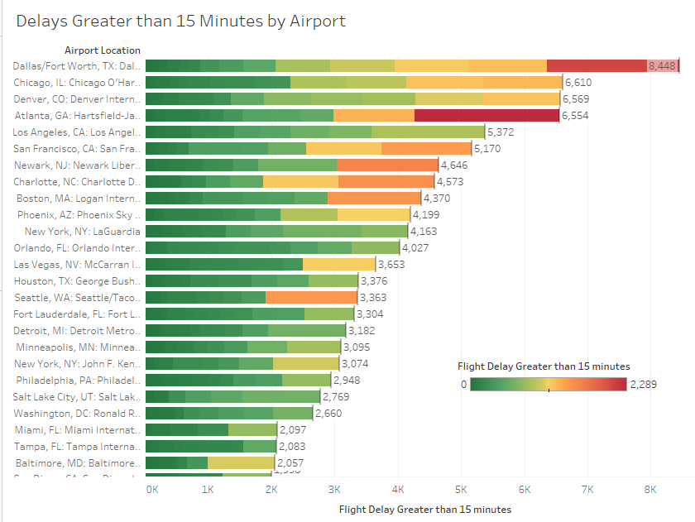
Flight Delays by Airport
Hypothesis
“If arriving flights encounter delays, then the number of arriving flight delays will be 15 minutes or longer”
Project Question
“Of the flight delays greater than 15 minutes, flights for the same aircraft, heavy air traffic, and weather delays, which has the most impact”?

Slide 9
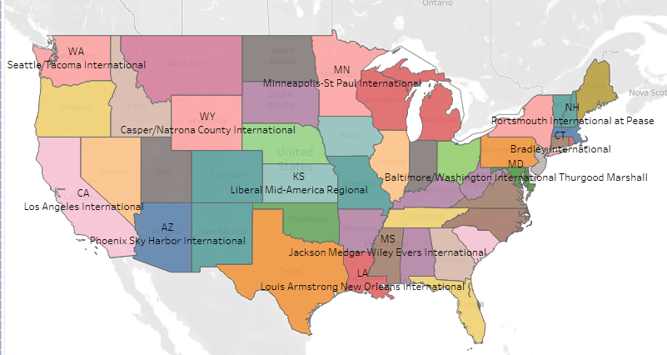
Choropleth Map of US and Airport Names

Slide 10
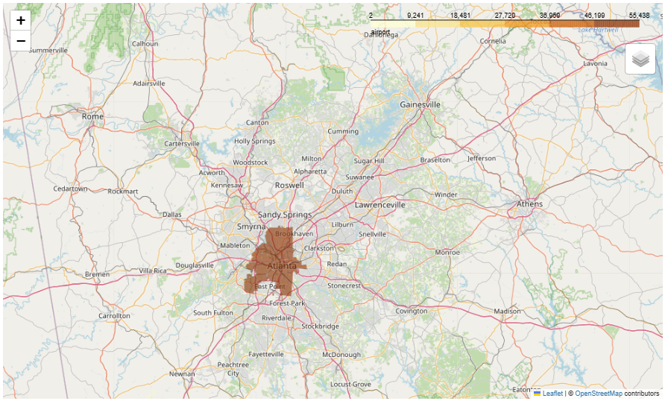
Choropleth Map of US and Airport Names
This analysis shows the cities where the airports are located. In this analysis Atlanta has the most with 55,438 arriving flights.

Slide 11
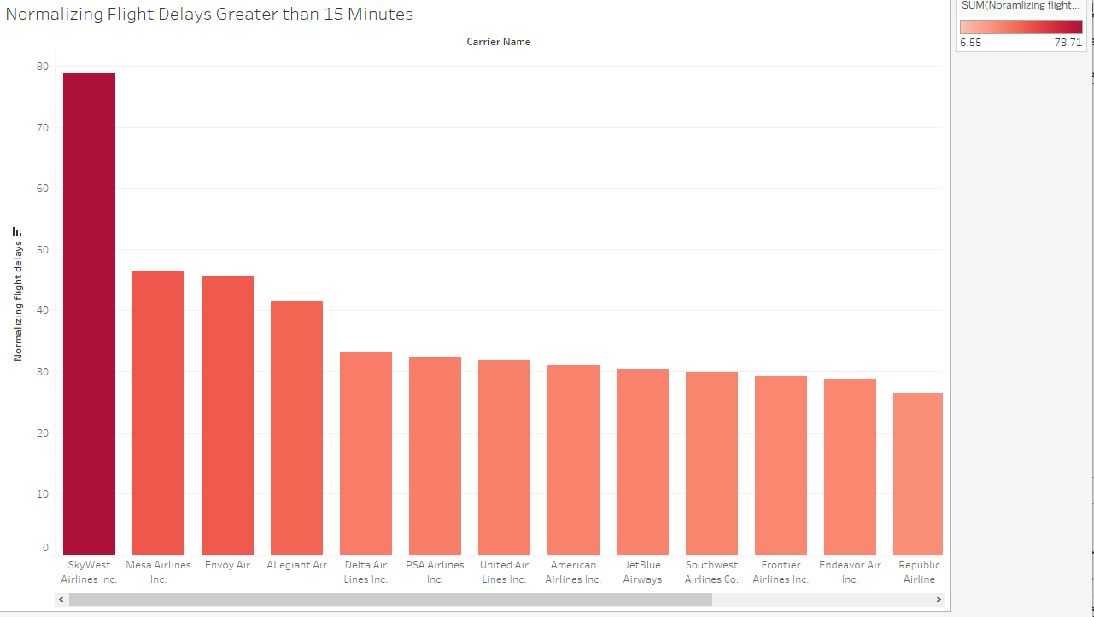
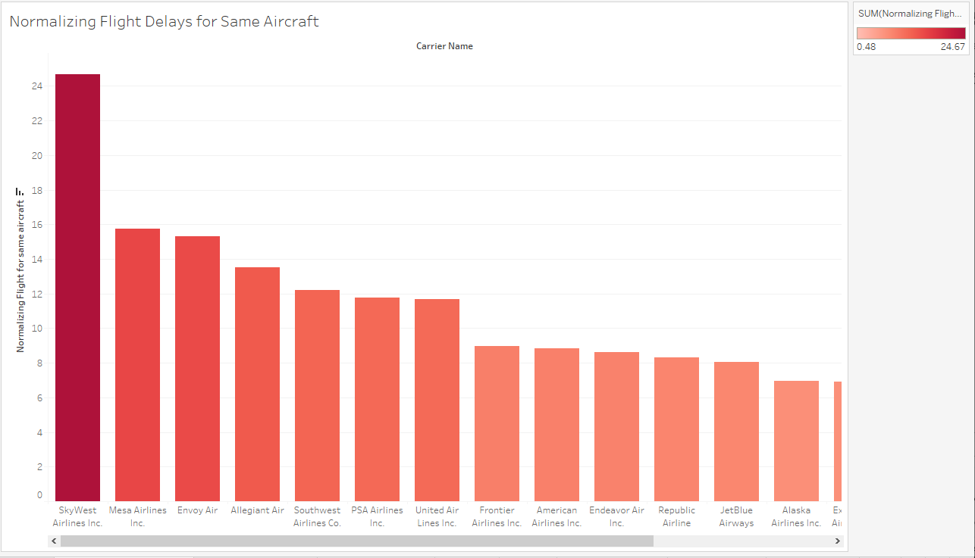
Airlines Affected by Delays
SkyWest Airlines Inc. is affected most with delays 15 minutes and greater. Followed by Mesa Airlines Inc. and Envoy Air.
SkyWest Airlines Inc. is most affected by flight delays for same aircraft. Followed by Mesa Airlines Inc. and Envoy Air.

Slide 12
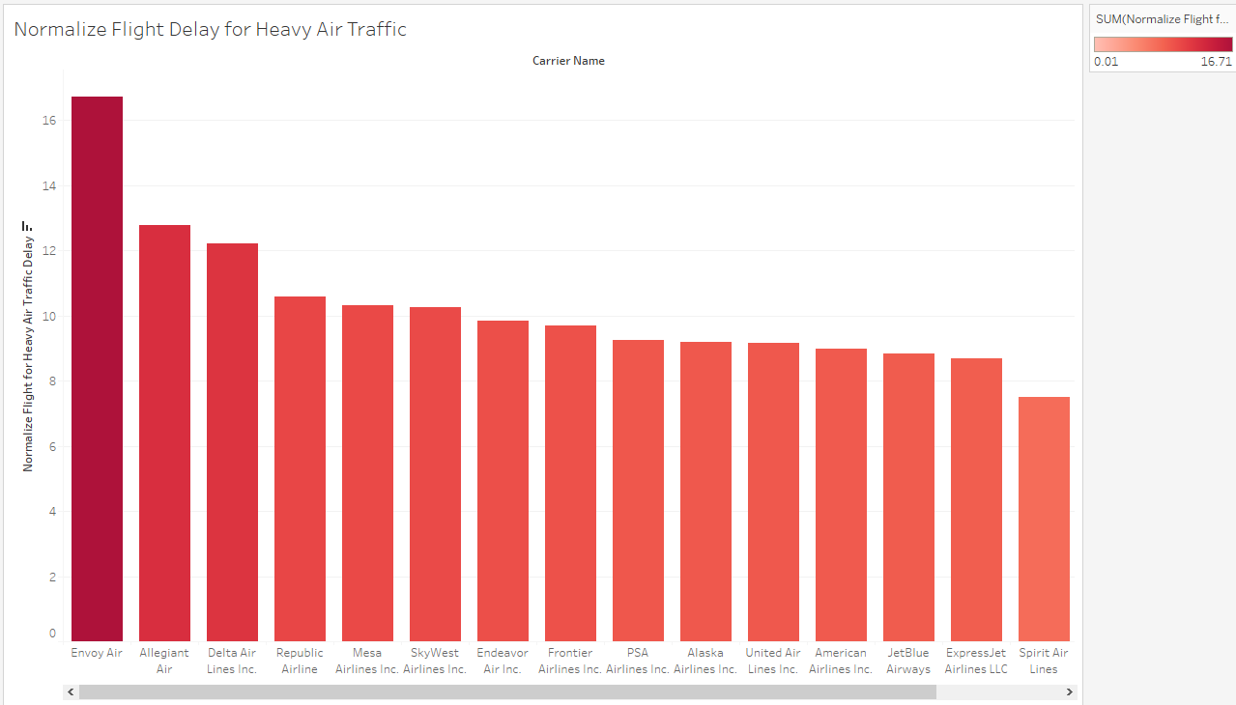
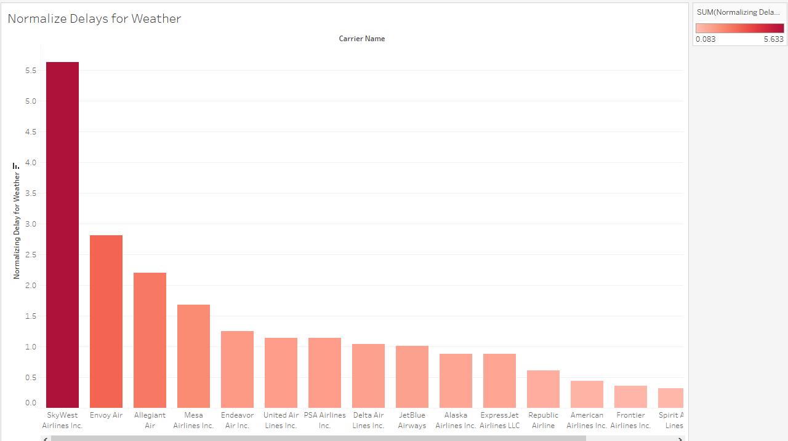
Airlines Affected by Delays
Envoy Air is most affect by heavy air traffic. Followed by Allegiant air and Republic Airline.
SkyWest Airlines Inc is most affected by weather delays. Followed by Envoy Air and Allegiant Air.

Slide 13
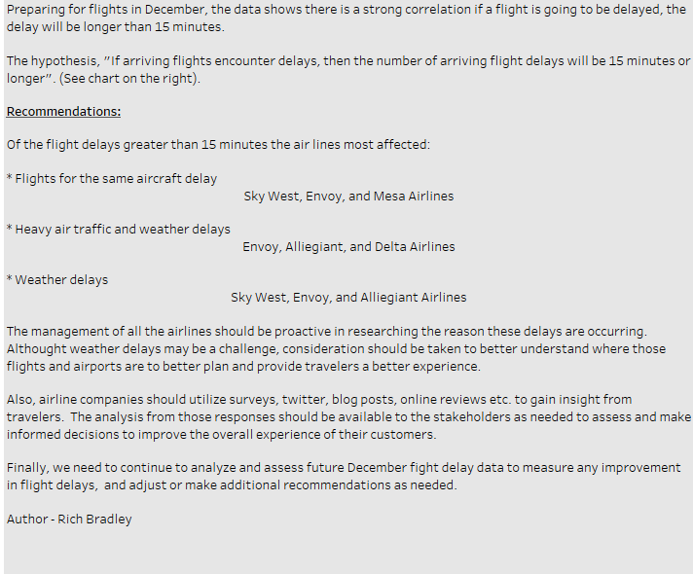
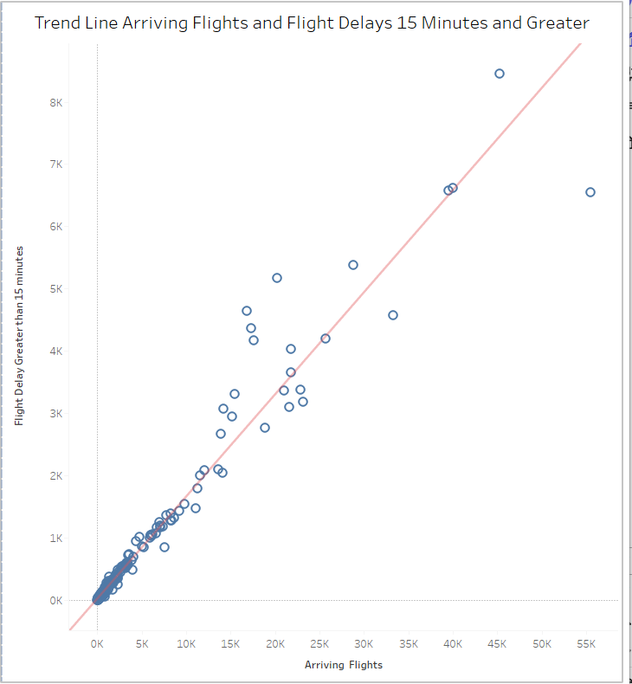
Recommendations and Next steps

Slide 14
Sources
Open Source: Kaggle.com
Original Author Eugeniy Osetrov (Owner)
Time Series Analysis
Data.gov Pubisher opendata.Maryland.gov
Maintainer Christine Howard

Slide 15
Links
Tableau
https://public.tableau.com/app/profile/rich.bradley/viz/FlightDelayProject_17130192454700/AirlineFlightDelays?publish=yes
GitHub
https://github.com/Rich-Brad/Airline-Delays
Open Source Kaggle.com Data Source
https://www.kaggle.com/datasets/eugeniyosetrov/airline-delays/data
Time Series Data Source
https://catalog.data.gov/dataset/mva-vehicle-sales-counts-by-month-for-calendar-year-2002-2020-up-to-october

Slide 16
Rich Bradley
Conclusion Slide
Data Analyst: Flight Delays Project
Advanced Analytics & Dashboard Design
Contact me with any questions, or if you would like to collaborate with me at rbbrad@gmail.com

